Slide 1
Help Your Child Become A Better Reader Independent Readers
Presented By:
Mia Brower & Nicole Weyandt
Reynoldsburg City Schools

Slide 2
In Session 2 We Will…
Review the five areas of literacy
Review advanced code and fluency
Learn strategies to read more difficult words
Learn ways to improve vocabulary and comprehension
Leave with resources and strategies to promote reading at home

Slide 3
The Big Five Ideas In Reading
Phonemic Awareness
Alphabetic Principle
Basic Code
Advanced Code
Fluency
Vocabulary
Comprehension

Slide 4
What Is Advanced Code?
The ability to understand that sometimes two or more letters represent a sound.
The ability to understand that most sounds can be represented in more than one way

Slide 5
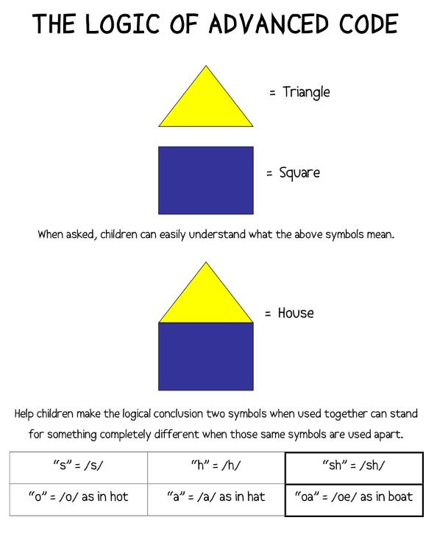

Slide 6
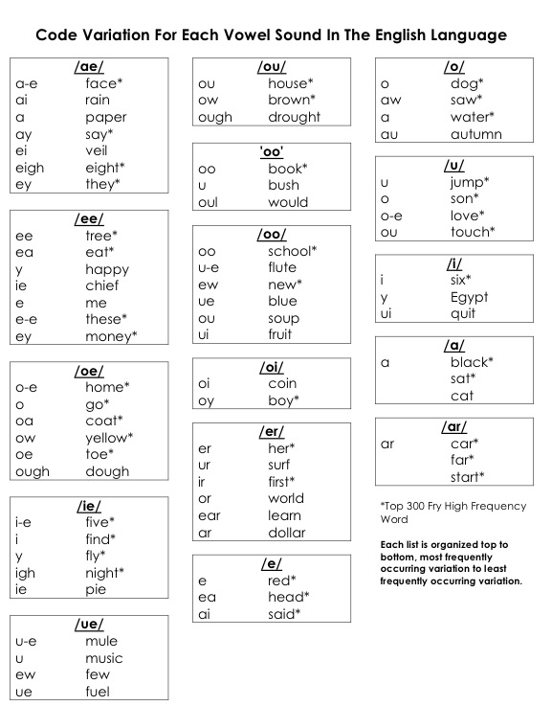

Slide 7
Sequence Of Word Decoding
Basic Code (Consonant-Vowel-Consonant)
Adjacent Code (Consonant Blends)
Advanced Code (Long Vowels)
Multisyllabic Words

Slide 8
What Are Multisyllabic Words?
A multisyllabic word is any word that has more than one syllable
1 Syllable | 2 Syllables | 3 Syllables | 4 Syllables
Cow | Table | Negative | Television
Door | Window | Popular | Category
Sheet | Mia | Excitement | Eligible
Face | Nicole | Adventure | Preferable
Chair | Running | Library | Testimony
Box | Children | Victory | Graduation

Slide 9
What If You Couldn’t Read Multisyllabic Words?

Slide 10
Here’s What You Missed!

Slide 11
Strategies for Reading Long Words
1. Circle the word parts(prefixes) at the
beginning of the word.
2. Circle the word parts (suffixes) at the end of
the word.
3. Underline the letters representing vowel sounds
in the rest of the words.
4. Say the parts of the word.
5. Say the parts fast.
6. Make it into a real word
reconstruction

Slide 12
Prefixes
A prefix comes at the beginning of a word and contributes to its meaning
Prefix | Meaning | Word
de | opposite | defrost
re | again | rewrite
un | not | unfriendly
pre | before | pretest
mis | wrongly | misbehave

Slide 13
Suffixes
A suffix comes at the end of a word and contributes to its meaning
Suffix | Meaning | Word
ful | full of | careful
less | without | fearless
tion | act or process | reconstruction
er | one who | farmer
er | comparative | higher
ed | past tense | walked

Slide 14
Can You Break These Words Apart?
birthday
depart
discriminate
unselfish

Slide 15
How Did You Do?
birthday birthday
depart depart
discriminate discriminate
unselfish unselfish

Slide 16
Why Is Vocabulary Important?
Vocabulary is very important for reading because comprehension improves when the reader knows what the words mean.
Without having an understanding of the words, it is nearly impossible to gain understanding from a passage.

Slide 17
Common Aspects Of Vocabulary
Categories
Prefixes & Suffixes
Synonyms & Antonyms
Multiple Meaning Words
homonyms
homophones
homographs

Slide 18
Synonyms & Antonyms
Synonyms are words that mean the same
big, large, enormous, gigantic
Antonyms are words that mean the opposite
tall & short
nice & mean

Slide 19
Multiple Meaning Words
Homonyms
Two or more words that are spelled and pronounced the same, but have different meanings
I deposited my money in the bank.
I walked along the river bank.
Homophones
Two or more words that sound the same, but have different spellings and meanings.
I ate breakfast this morning.
My big brother is eight years old.
Homographs
Two or more words that are spelled the same, but are pronounced differently and have different meanings.
The flag was blowing in the wind.
I had to wind the kite string around the spool.

Slide 20
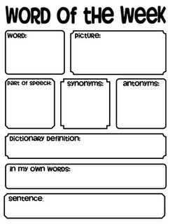
Ways To Build Vocabulary
Vocabulary Mapping
Reading and discussing books
Modeling good vocabulary
Expanding Expression Tool

Slide 21
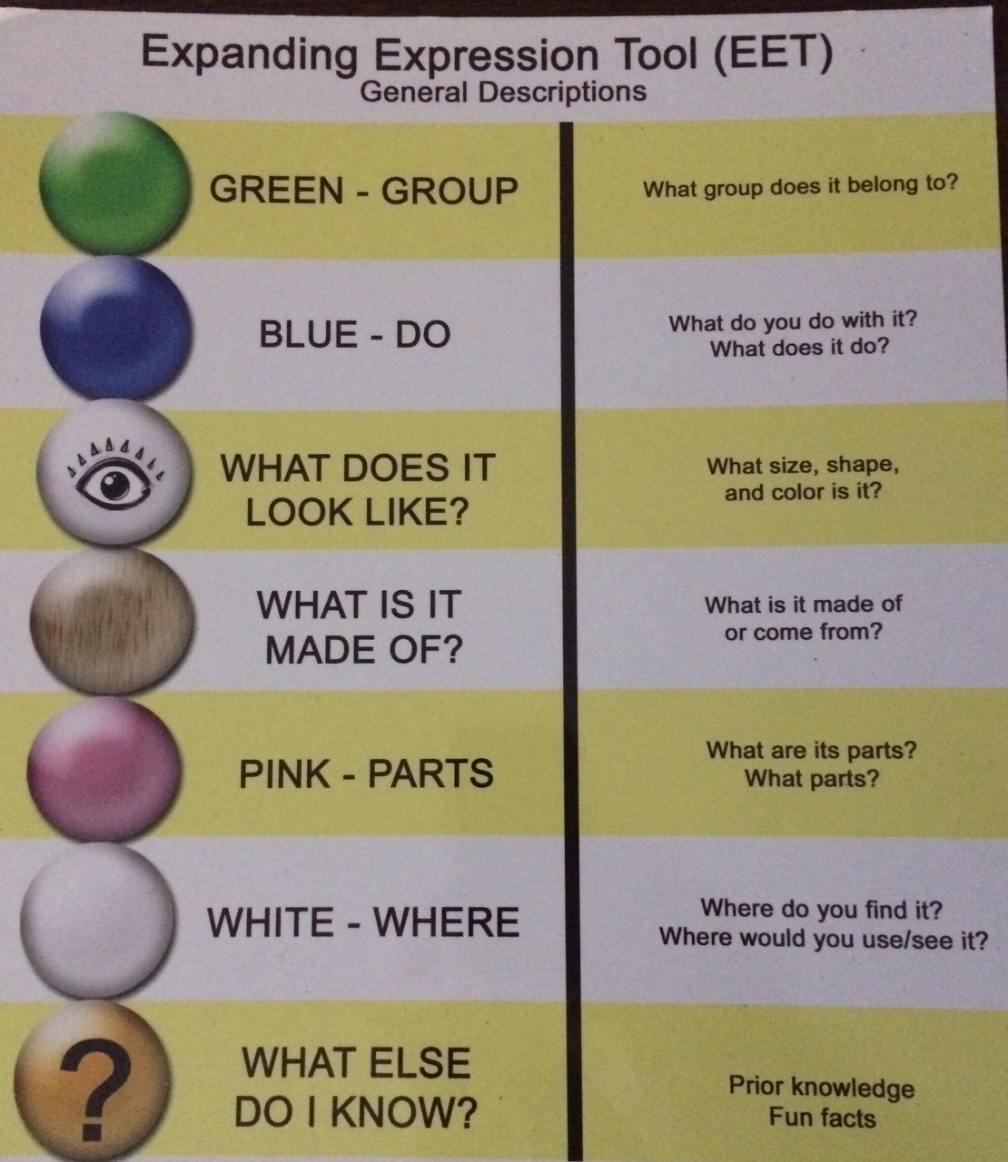

Slide 22
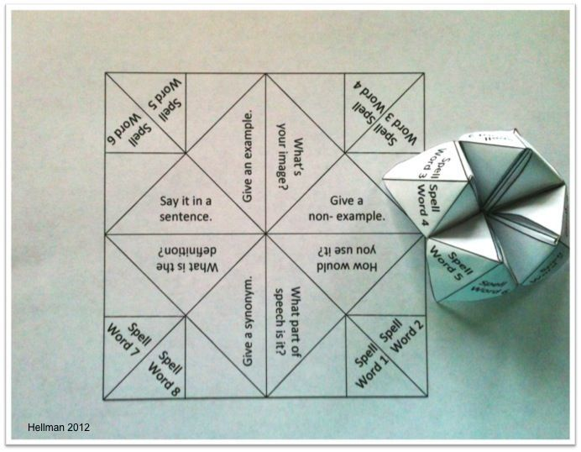
Vocabulary Cootie Catcher

Slide 23
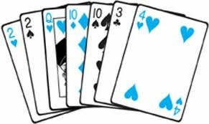
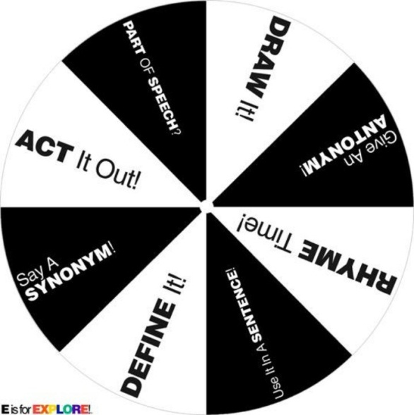
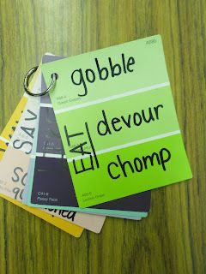
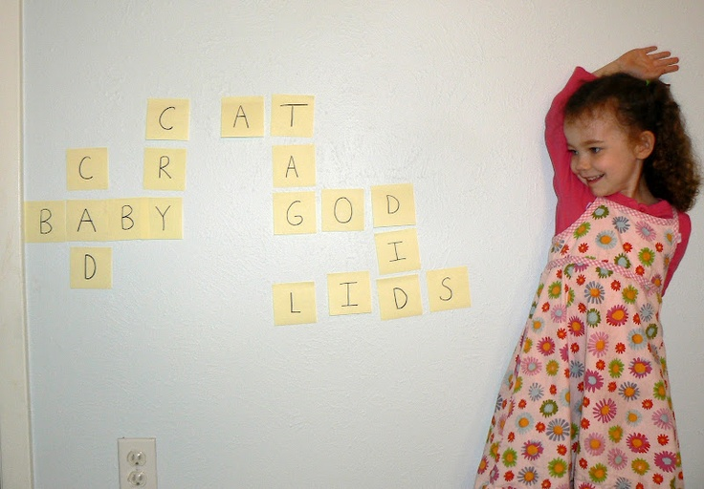
Activities To Do At Home

Slide 24
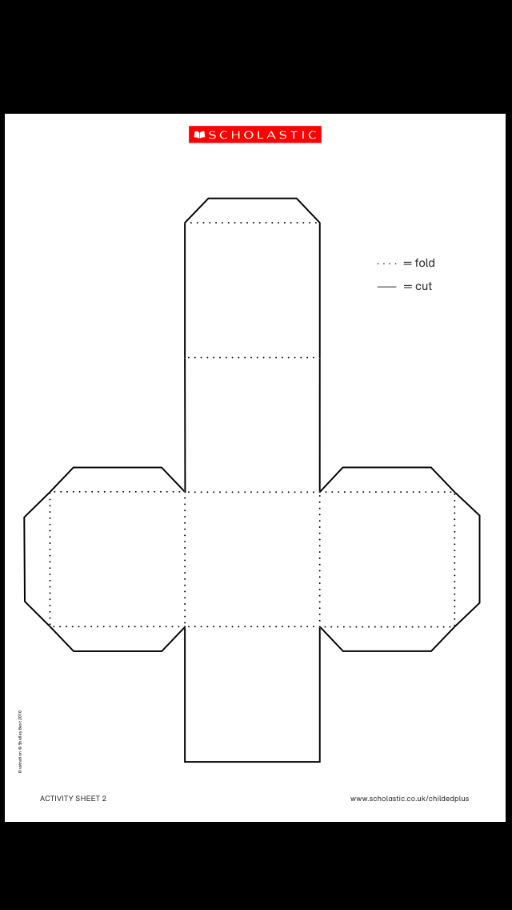
Vocabulary Make And Take
Define the word
Use it in a sentence
Name a synonym
Name an antonym
Name a word that rhymes
Act it out

Slide 25
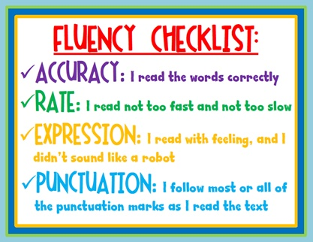
Review Of Fluency

Slide 26
Why Is Fluency Important?
A nonfluent reader puts a large amount of effort into decoding words. By the time such a reader finishes a sentence, he or she may forget what the sentence was even about. Comprehension is blocked because the process of decoding takes so much time and effort the short-term memory can’t grasp the fragmented input of information.
By contrast, a fluent reader reads in smooth and continuous phrases and the brain can retain and comprehend what is read.
www.k12reader.com

Slide 27
Why Is Fluency Important?
While fluency alone will not guarantee strong reading comprehension skills, it is absolutely a necessary component.
Not only is fluency important to oral reading, but successful silent reading requires fluent reading as well.
www.k12reader.com

Slide 28
Ways To Do Repeated Reading
Partner Reading
Take turns reading a sentence or page
Choral Reading
Read out loud together at the same time
Echo Reading
One person reads then the other person echoes the sentence that was just read
Notes:
Demonstration of each given by Mia & Nicole

Slide 29
Activities For Fluency
Reading in different voices
Fluency phrases
Poetry
Recorded readings
Modeling fluent reading

Slide 30
What Is Comprehension?
Reading comprehension is the act of understanding what you are reading
It occurs before, during, and after reading
It does not develop quickly. Strategies must be taught over an extended period of time.
As the complexity of the text increases, the difficulty of comprehension also increases.

Slide 31
Key Terms For Comprehension

Slide 32
Questions To Ask Before Reading
Looking at the title, cover and illustrations/pictures, what do you think will happen in this book?
What makes you think that?
What characters do you think might be in the book?
Do you think there will be problem in the story? Why?
What do you already know about the topic of this book?
Does the topic or story relate to you or your family? How?
Do you think it will be like any other book you’ve read?
If so, which one, and how do you think it will be similar?

Slide 33
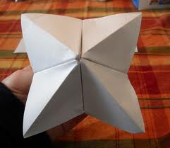
Comprehension Make And Take

Slide 34
Questions To Ask While Reading?
What has happened so far in the story?
Can you tell me using sequence words (first, then, next, after, finally, etc.)
What do you predict will happen next?
How do you think the story will end?
Why do you think the character did ____________?
What would you have done if you were the character?
How would you have felt if you were the character?
When you read, what pictures did you see in your head?
How did you imagine it looked like?
What are you wondering about as you read?
What questions do you have?

Slide 35
Questions To Ask After Reading
Why is the title a good title for the book/story?
If you had to give it a different title, what would be another good title for it?
Were your predictions correct?
How did the character try to solve the problem?
What happened because of the problem?
Did any of the characters change through the story?
Who changed, and how did they change?
Why do you think the author wrote this?
What is the most important point that the author is trying to make?

Slide 36
Questions To Ask After Reading
What was your favorite part? Why?
If you could change one part, what would you change?
If you could ask the author a question, what would you ask?
Can you retell the story in sequence order (use your fingers and sequence words: first, second, then, next, etc.)
Is there a character in the story that reminds you of someone you know?
If so, who are they like, and why do you think that?
Does this book remind you of another book you know?
Does it remind you of something you’ve experienced in real life?

Slide 37
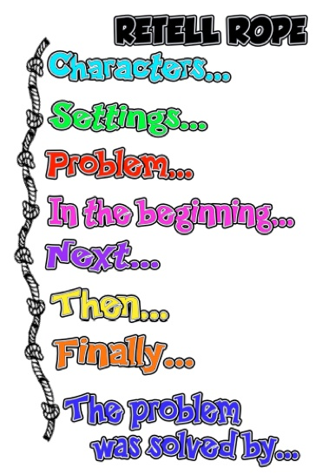
Comprehension Make And Take

Slide 38
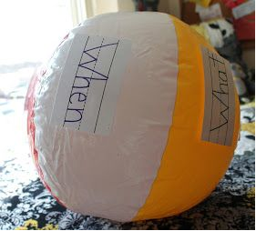
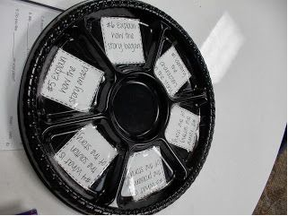
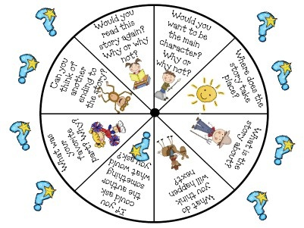
Activities To Do At Home

Slide 39
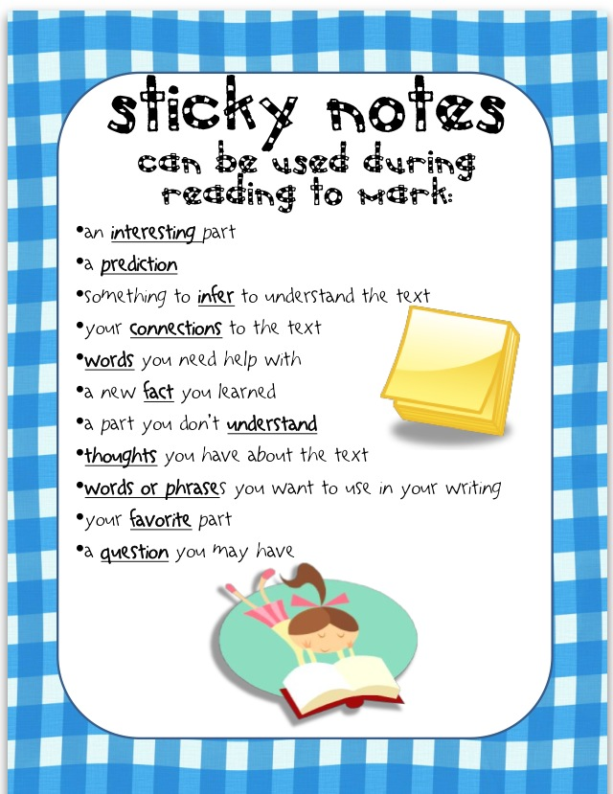

Slide 40
Questions

Slide 41
When Will You See Us Again?
Thursday March 20, 2014
Hannah Ashton Middle School
6:00-8:00 PM

Slide 42
Contact Information
Mia Brower
mbrower@reyn.org
www.mrsbrower.weebly.com
Twitter: @BrowerHMTigers
Facebook: www.facebook.com/mrsbrowerHMTigers
Nicole Weyandt
nweyandt@reyn.org
www.missweyandt.weebly.com
Twitter: @WeyandtHMtigers
Facebook: www.facebook.com/MissWeyandtsRoom

